Slide 1



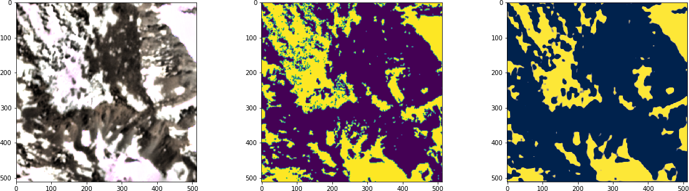
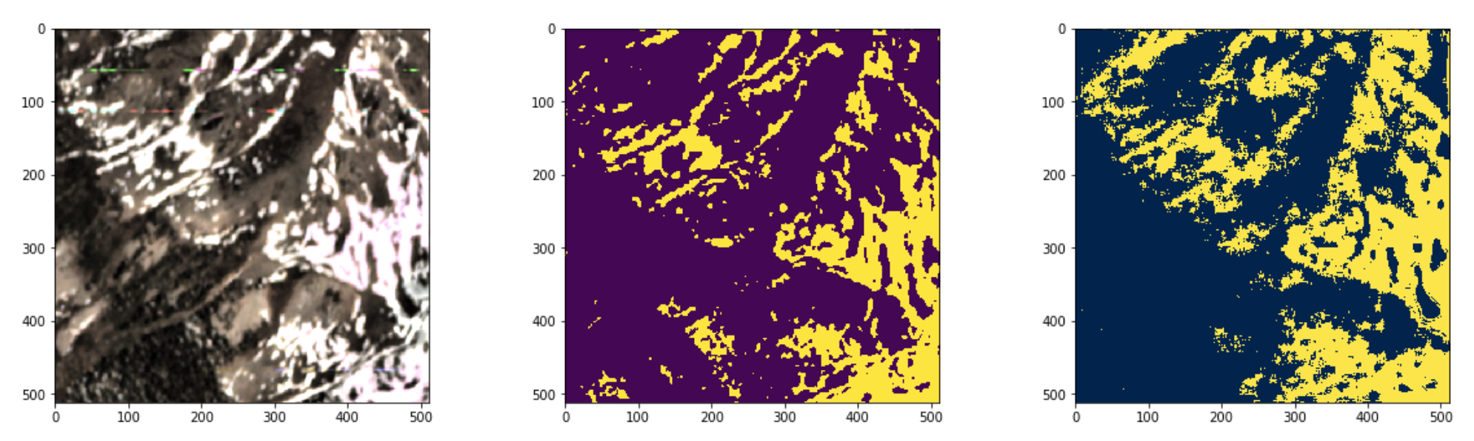
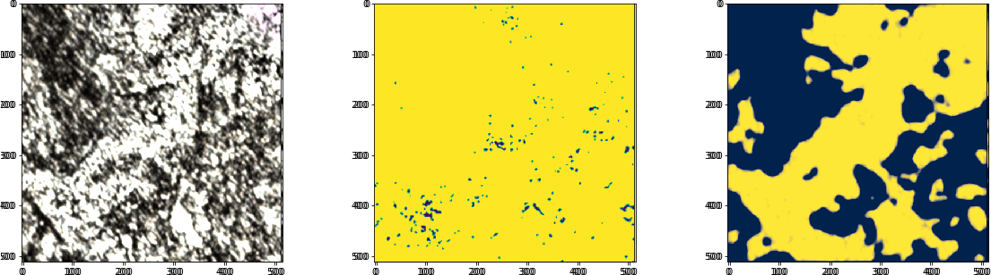
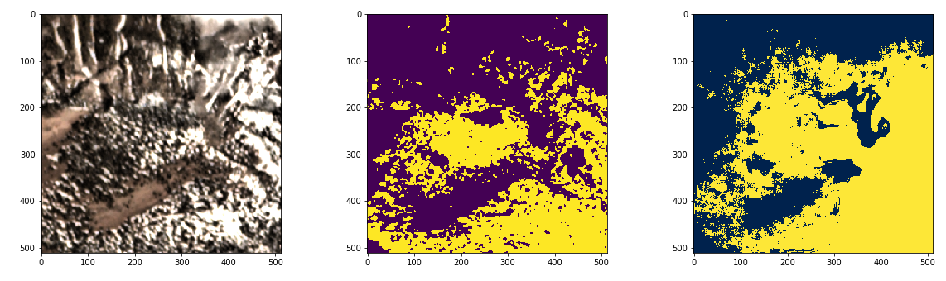


Assessing High-Resolution CubeSat Imagery to Infer Detailed Snow-Covered Areas for Studying Changes in Mountain Ecosystems
Anthony Cannistra and Nicoleta Cristea
University of Washington, Seattle – tonycan@uw.edu
Neural Networks can leverage CubeSat imagery to detect snow in mountains in fine detail.
Many landscape-scale hydrology and ecology studies require snow observations at daily-to-weekly timescales with sub-10m resolution.
MODIS and Landsat products cannot directly fulfill this data need. We use Planet, a 3m, 4-band, ~daily CubeSat imagery product.
This project bridges the gap between accurate but expensive/sparse observations and imagery for snow.
Advances in computer vision techniques, aided by convolutional neural networks (CNNs), enable this technique.
Public cloud compute infrastructure greatly simplifies the workflow required to complete this analysis.
Data: we merge two high-res remote platforms to jointly leverage their advantages.
Analysis: a cloud-based workflow allows for quick experimentation and reproducibility.
Challenge:
Snotel and Airborne lidar is accurate, but expensive and sparse.
Planet Labs imagery is global, high-resolution, but narrow bandwidth means traditional snow detection approaches (e.g. spectral indices) do not work.
Availability:
The NASA Airborne Snow Observatory (ASO) produces high-resolution (3m) snow depth products at a weekly-to-monthly revisit time across several U.S. watersheds.
Planet Labs, a commercial satellite imagery company, provides a 4-band (R, G, B, NIR), 3m, 1-5 day revisit imagery product to researchers.
We use ASO-derived snow masks to create “training data” for a neural network-based machine learning model. The CNN uses spatial context to make pixel-level predictions.
We reserve a segment of these data to assess model performance (e.g.: “How well does the model identify snow in an image it has never seen before?”)
Figure 1: Remote sensing platforms observing transitional snowpack (blue shades are lower, and green shades are higher snowpack density)
Figure 3: ASO collect over Tuolumne Watershed, California USA.
Figure 2: Atmospheric transmission/ ground reflectance for the wavelengths used to observe snow cover
Figure 4: Planet 4-band image over Tuolumne Watershed, California, USA. © 2019 Planet Labs Inc., All Rights Reserved.
Figure 5: Conceptual schematic of Amazon Web Services (AWS) based cloud workflow architecture, from imagery acquisition and preprocessing to machine learning.
Results: this neural network approach is a powerful technique across several snow classes, and there’s room for improvement in heavily forested areas .
code + docs available: https://github.com/acannistra/planet-snowcover
Tuolumne, CA, USA Snow class: Maritime / Alpine
Grand Mesa, CO, USA Snow class: Continental
Conclusions & Next Steps
We can use these trained CNN models to build snow masks from Planet imagery.
This result paves the way for 3m, ~daily snow masks during the ablation period, which is invaluable data for mountain ecology and hydrology research.
Several research questions follow:
How does model performance vary across regions and land-cover types?
Can models be used in regions other than the one on which they were trained?
RGB Image
ASO Mask
Model Prediction
Good Performance in clearly-differentiable terrain.
RGB Image
ASO Mask
Model Prediction
Good Performance in clearly-differentiable terrain.
Needs Improvement in heavily-forested areas – model only finds gaps.
Surprisingly decent performance in forested areas.
These results are from a model trained using a network pre-trained with Tuolumne data.
This work is supported by NSF IGERT grant DGE-1258485, the eScience Institute at UW, Planet Labs Research, the ESIP Incubator program, the NASA Terrestrial Hydrology program, and the NSF Graduate Research Fellowship Program.

